Slide 1
Spatial Structure preserving feature pyramid network (SSPFPN)
Hao Lan

Slide 2
Contents
Introduction
Proposed Method
Experiments

Slide 3
INTRODUCTION
Semantic image segmentation approaches proposed lately(2019) have been mostly based on Fully convolutional Networks (FCNs)
Use large receptive fields: convolutional kernel with large receptive field smooth the detailed edges
Too many pooling layers: loses many detailed information of the image while zooming out the feature map
These operations often cause low spatial resolution inside deep layers, which leads to spatially fragmented prediction
To address this problem, the author exploit the inherent multi-scale and pyramidal hierarchy of deep convolutional networks to extract the feature maps with different resolutions and take full advantages of these feature maps via a gradually stacked fusing way.

Slide 4
FCN
Common limitation: No explicit pixel grouping mechanism, suffer from low spatial resolution
solutions:
Deconvolution network
FCN (Fully Convolutional Network) + CRF (Conditional Random Fields)
U-Net
DeepLab-based methods
Other embedding-based methods
Common limitation again: The increment number of network parameters, which leads to the increment of the computational complexity.
FPN Ignores fully connected layers,
Which means its output could be 2D matrix, thus faster than CNNs.
By fusing early layers and deep layers, it retains both high spatial structure and discriminative capacity
FPN

Slide 5
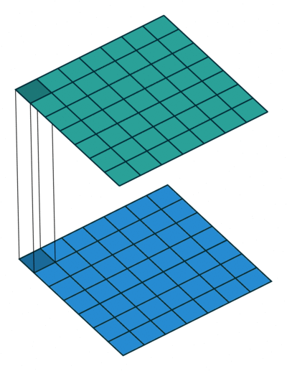
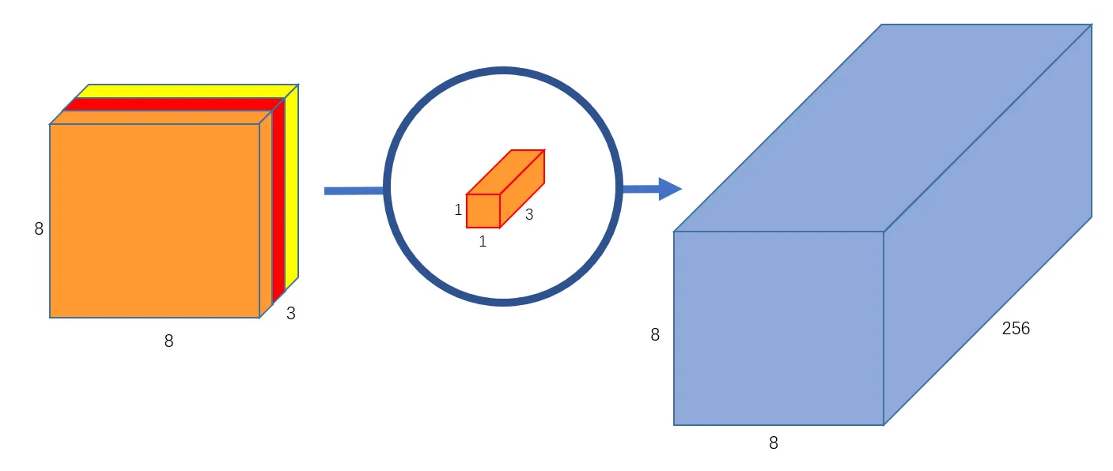
Introduction for proposed method
FPN
Skip / Residual connection
Upsample the features from deeper layer with stride of 2. Then stack them on the features from shallower layer.
Lateral connection
Then, a convolutional layer with kernels of 1 × 1 is followed to fuse these stacked features. The fused feature preserves the spatial structure information of the image
SSPFPN
Novel loss
meanwhile, it owns strong discriminative capability for pixel classification, we propose a novel loss term for the network.
Affinity matrixes
Two model-based spatial affinity matrixes are proposed, which are used to depict the pixel-level relationships in the input image and predicted category label map respectively, their cosine distance is backward propagated to the network.

Slide 6
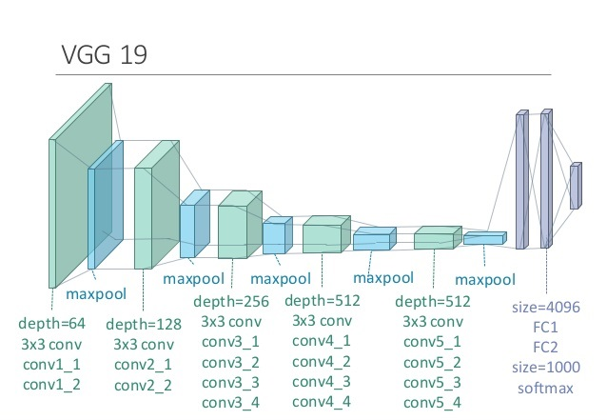
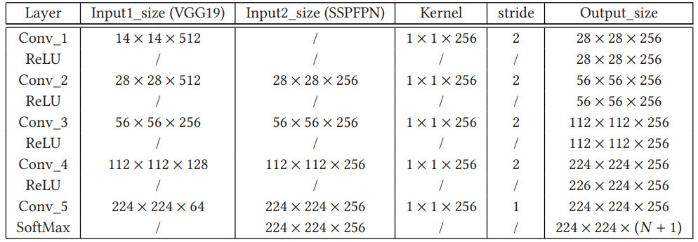
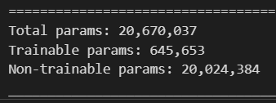
Proposed structure
The VGG19-Net pre-trained on ImageNet is used to extract feature maps of images with fixed input size of 224x224x3, the last feature map is in shape of 14x14x3
SSPFPN is then fuse the extracted feature maps with different sizes
Consider object detection furthermore, if the objects in the image are all pixel-level ones in the image, this task is transformed to semantic image segmentation, which is a special object detection task.

Slide 7
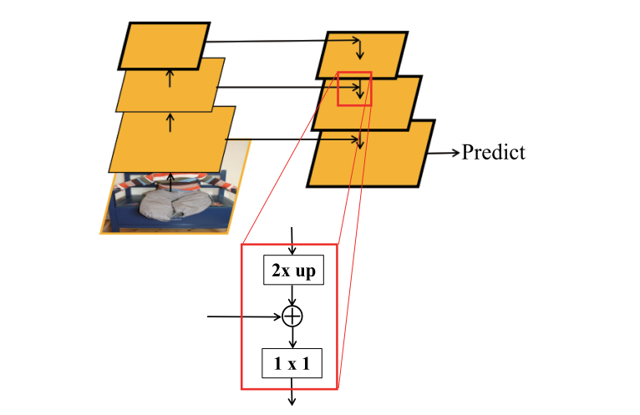

Slide 8
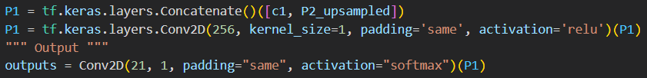
Lateral connection
X2
Nearest neighbor upsampling by default
Skip connection
Lateral connection
X2
…

Slide 9
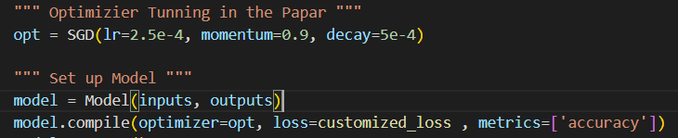
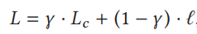
Loss
Stochastic Gradient Descent tuned as described in the paper
Lc → classification loss (softmax loss categorical crossentropy)
γ → is a constant used to adjust the two aspects in the equation The bigger the γ , the more important the pixel classification and the less important the spatial affinity.
→ proposed loss term that emphasizes the pixel-pair-based similarity in the image
(It’s a cosine loss term based on two constructed affinity matrices)

Slide 10
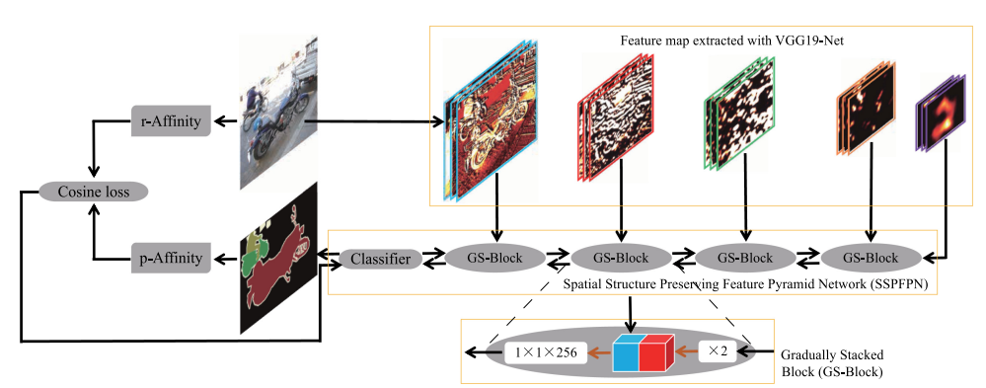

Slide 11
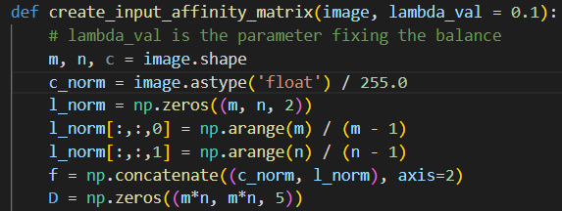
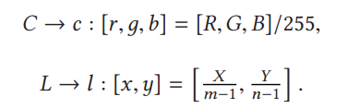
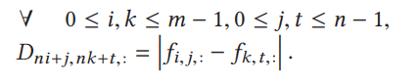
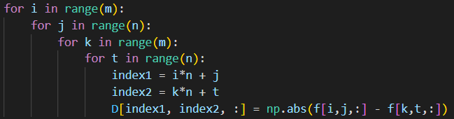
Spatial Affinity Matrix
- Describe the spacial relationship of pixels in the image
Image:
C = [R,G, B] and L = [X, Y] For m x n x 3 color images
We normalize and concatenate the C and L vector of each pixel as a new vector f = [C;L]
Then we calculate the distance matrix D = mn × mn × 5

Slide 12
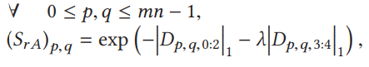
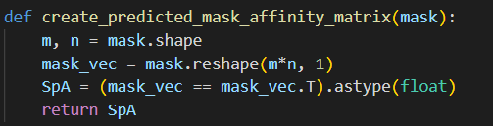
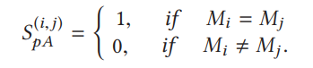
Finally, the affinity matrix for input image (SrA) is calculated using Equation:
Where λ is a hyperparameter constant to balance the relationship of RGB intensity and the location information
Affinity matrix for predicted label mask (SpA):
We reshape the label mask to a vector M = mn×1 (flatten)
SpA is given by:
According to the invariability of images affinity, the matrix SrA and the matrix SpA should have the same spatial characteristic

Slide 13
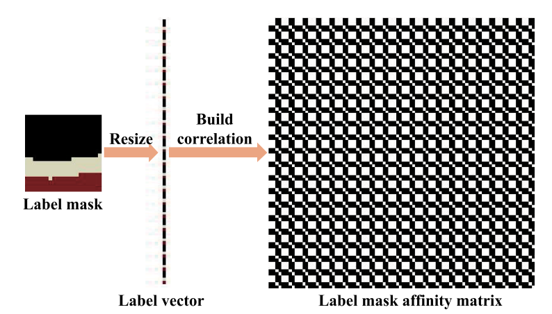

Slide 14
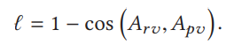
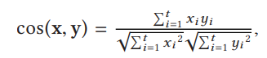
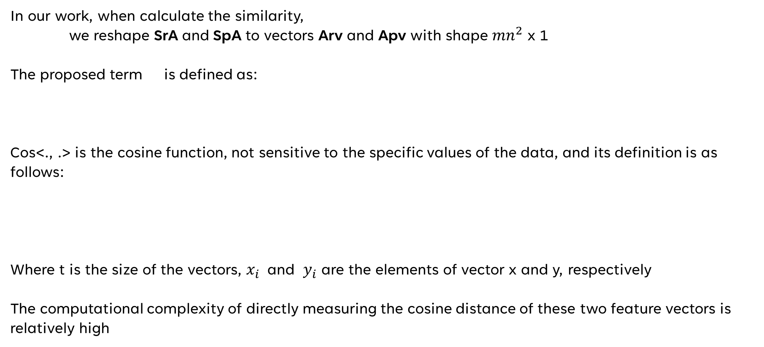
In our work, when calculate the similarity,
we reshape SrA and SpA to vectors Arv and Apv with shape ${mn}^{2}$ x 1
The proposed term is defined as:
Cos<., .> is the cosine function, not sensitive to the specific values of the data, and its definition is as follows:
Where t is the size of the vectors, $x_{i}$ and $y_{i}$ are the elements of vector x and y, respectively
The computational complexity of directly measuring the cosine distance of these two feature vectors is relatively high

Slide 15
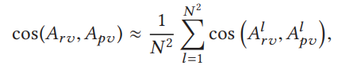
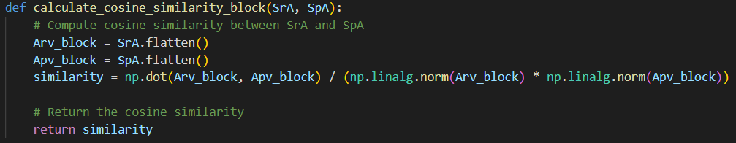
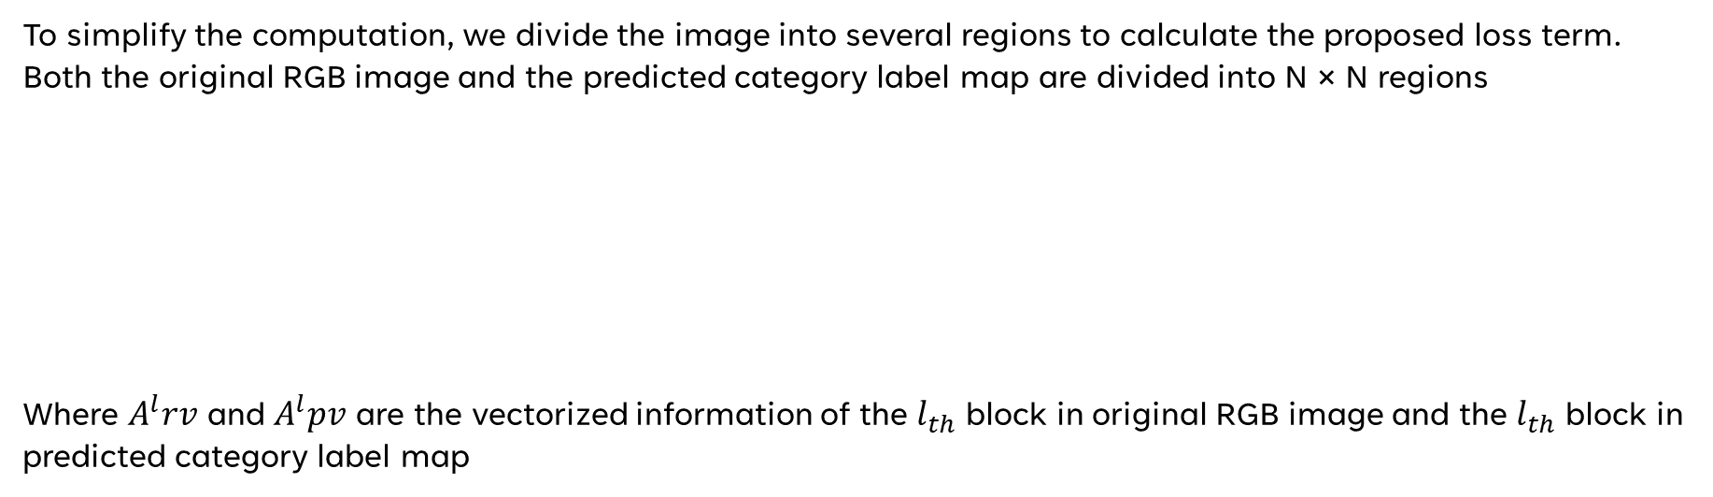
To simplify the computation, we divide the image into several regions to calculate the proposed loss term. Both the original RGB image and the predicted category label map are divided into N × N regions
Where $A^{l}rv$ and $A^{l}pv$ are the vectorized information of the $l_{th}$ block in original RGB image and the $l_{th}$ block in predicted category label map

Slide 16
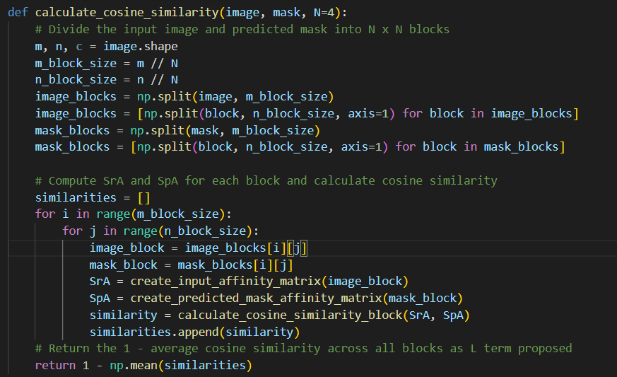

Slide 17
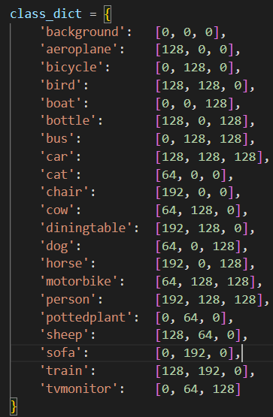
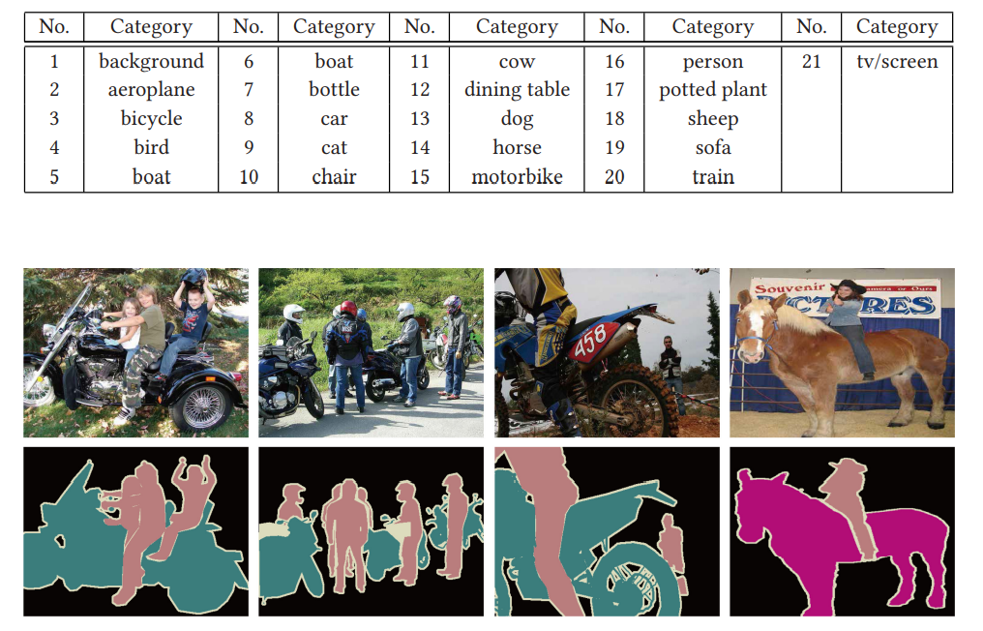
EXPERIMENT
PASCAL VOC 2012 Dataset

Slide 18
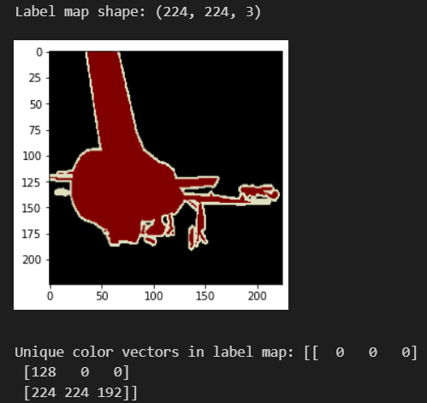
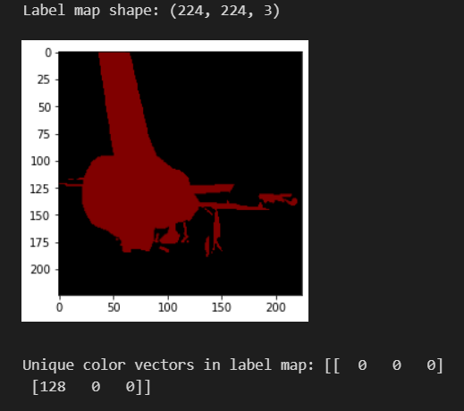
One_hot_encoder
for the label maps
224 x 224 x 3 label_map converted to one_hot_map 224 x 224 x #ofClasses (21)
See if dict(i).color in the label map
YES:
Such that one_hot_map[x][y][i] = 1, where i is the sequence of the class color. This means aeroplane is detected in the original image
one_hot_map[x][y] = [0,1,0,0,0,0,0,0,0,0,0,0,0,0,0,0,0,0,0,0,0]

Slide 19
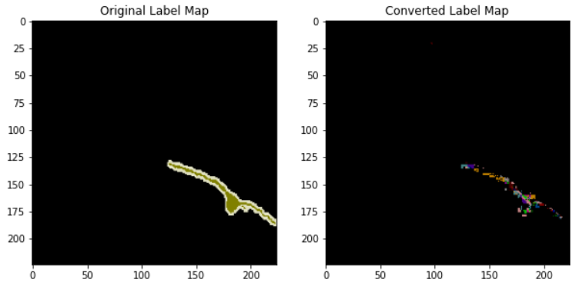
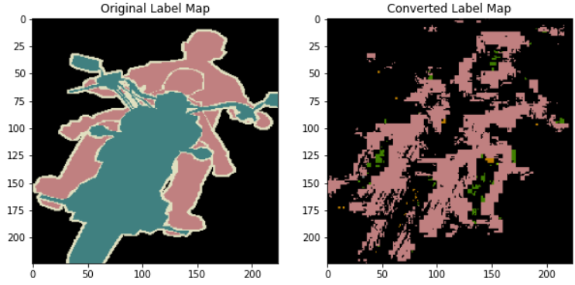
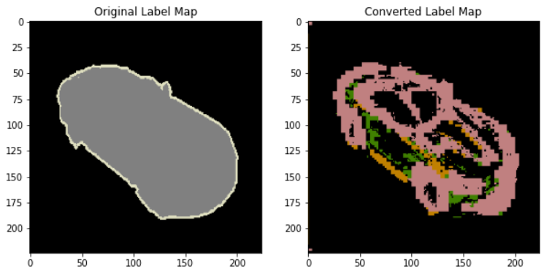

Difficulties:
Ambiguity & Lack of info in the paper & counter-intuitive loss
- training details
- label conversion
- customized loss demands input images
Imbalance data
Model complexity limits (structure)
- IO_U bottleneck of 0.477
Hardware limitation
- Intel(R) Core(TM) i7-8750H CPU
- NVIDIA GeForce GTX 1060 (6GB RAM)

Slide 20
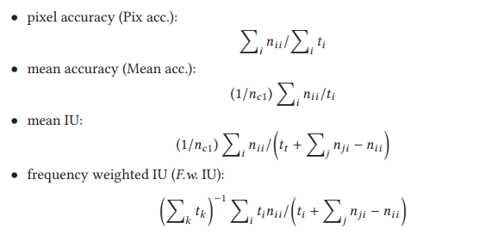
Evaluation:

Slide 21
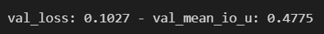
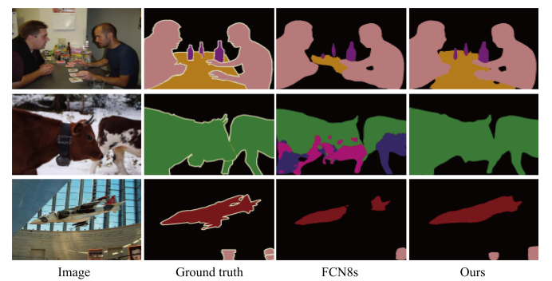
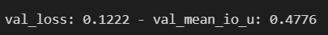
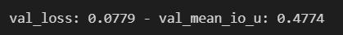
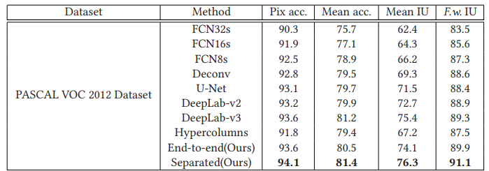
Evaluation
Naïve customized model
Proposed structure
FCN8s

Slide 22
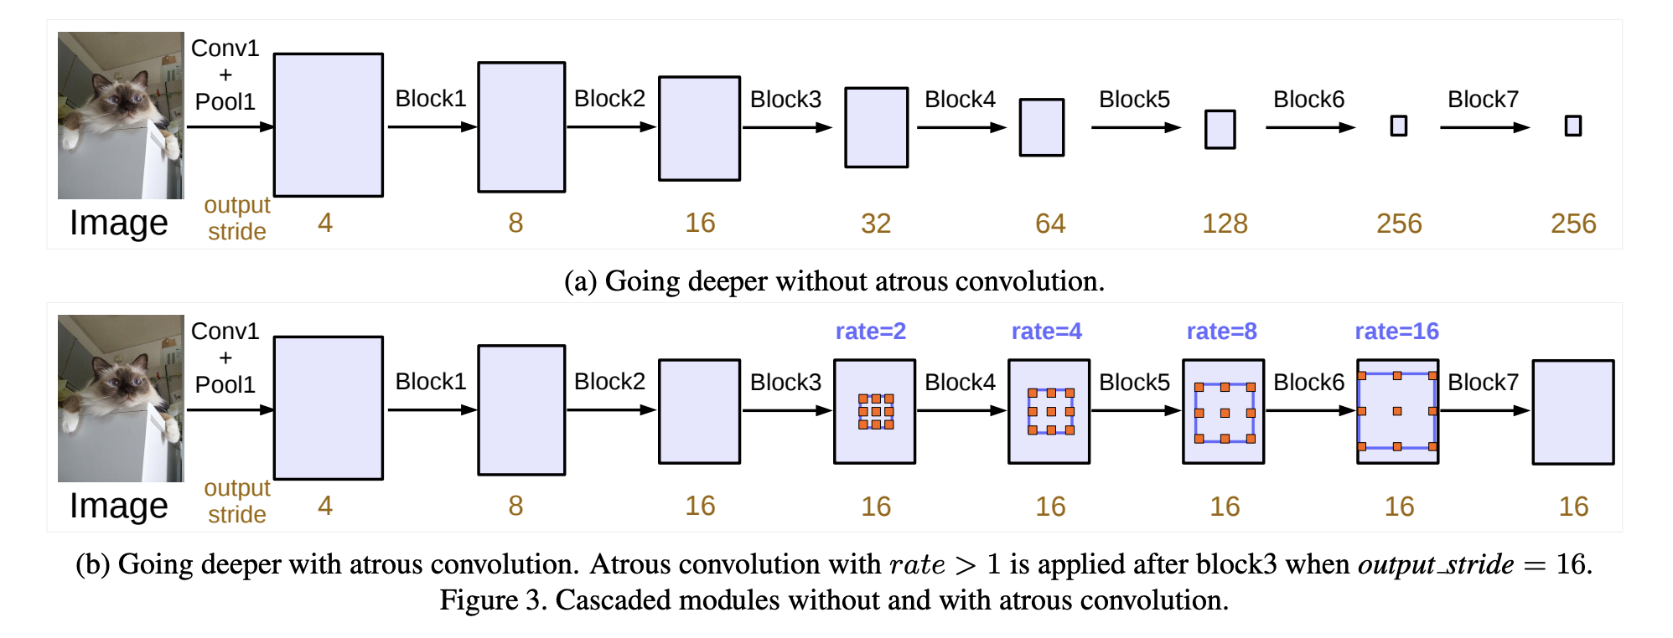
DeepLabV3+
Atrous Spatial Pyramid Pooling (ASPP)
allows the model to capture larger-scale contextual information without downsampling the feature map or increasing the number of parameters in the kernel.

Slide 23
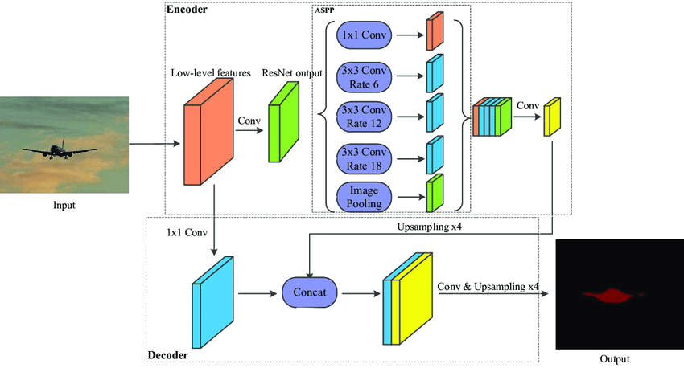

Slide 24
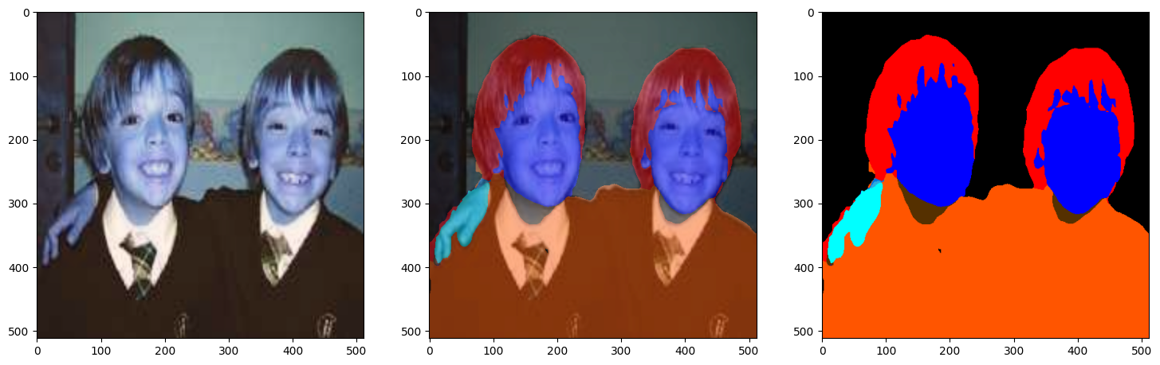
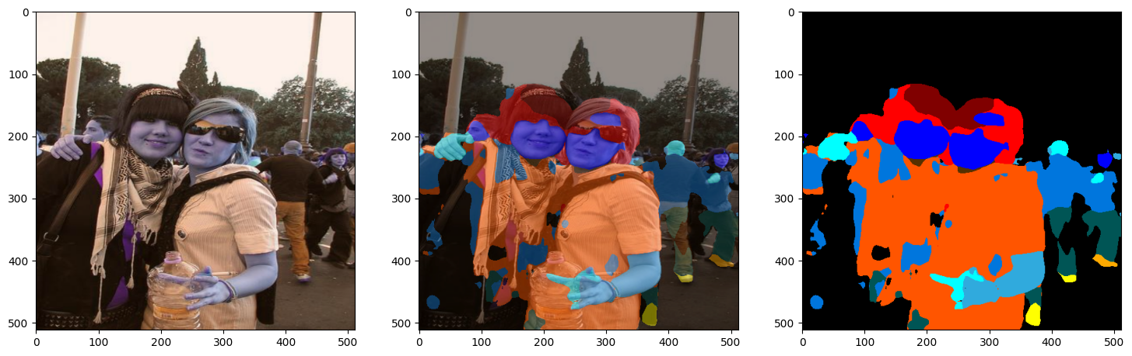
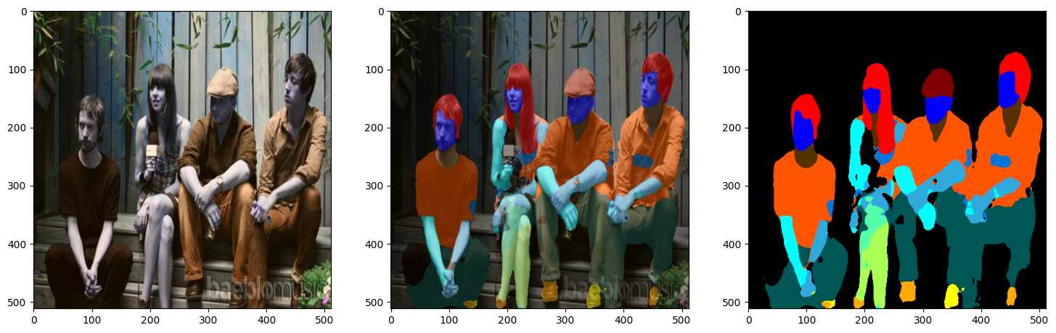
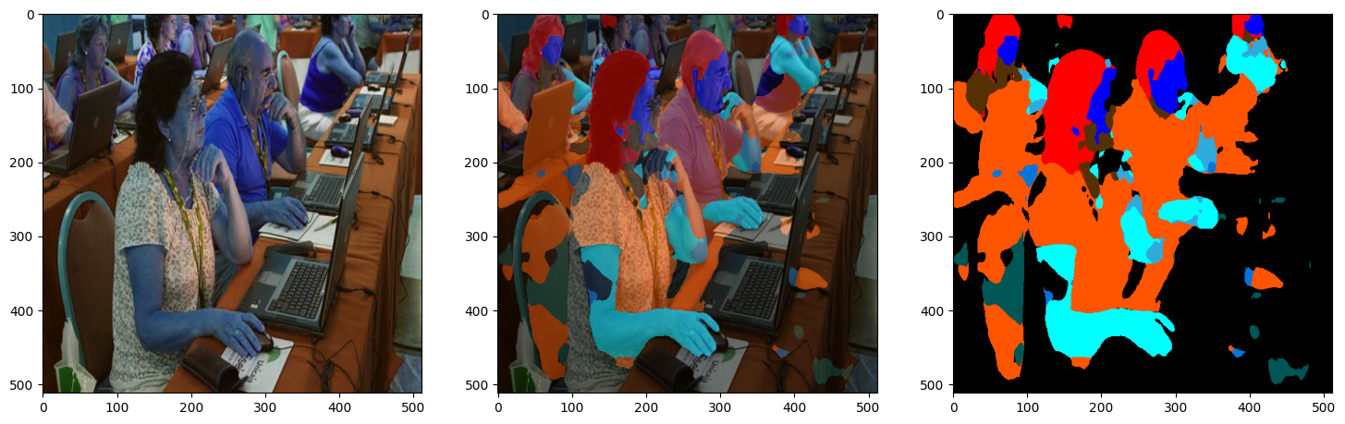
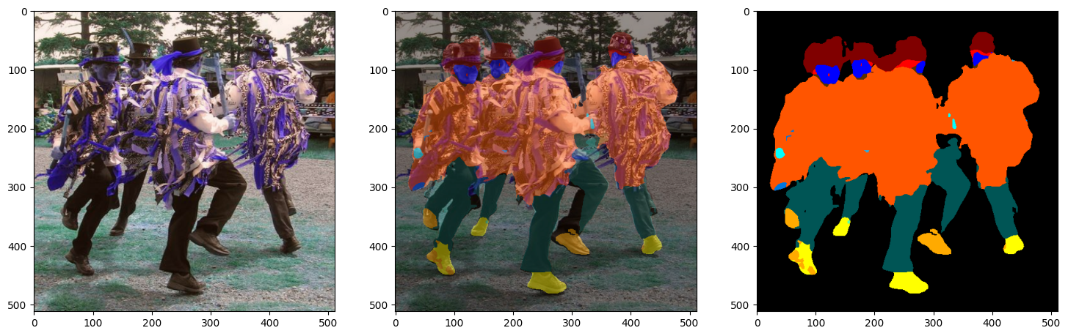
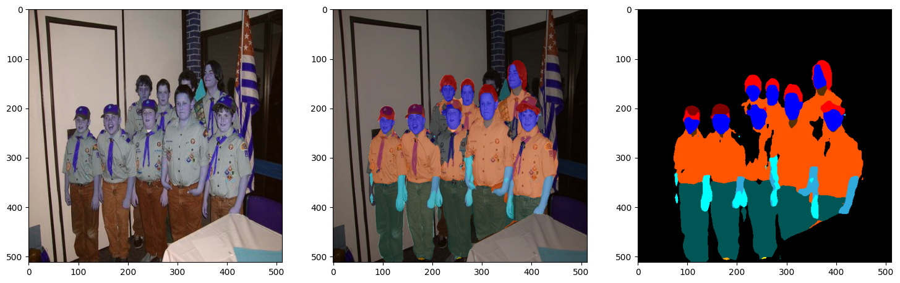
DeepLabV3+ (resNet50 backbone)
Reference to the Tensorflow official, a different dataset CIHP (Instance-level Human Parsing ) is used

Slide 25
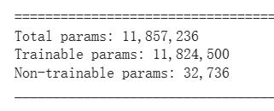
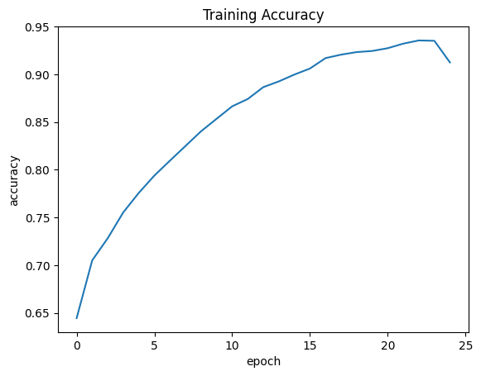
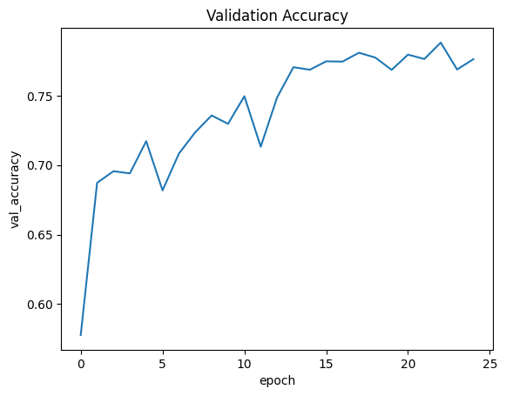
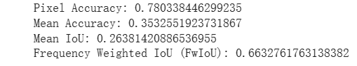


CIHP dataset:
Crowd Instance-level Human Parsing (CIHP) dataset has 38,280 diverse human images. Each image in CIHP is labeled with pixel-wise annotations for 20 categories
DeepLabV3+

Slide 26




DeepLabV3+ On PASCAL VOC12
Some of the predictions are reasonable, but still getting incomplete/mis-classified
results.
26

Slide 27



ResNet50-Unet (4, 4) stride transpose
val_accuracy: 0.7681
val_precision: 0.7848
val_recall: 0.7333
val_mean_io_u: 0.4781
700 trained (eva on 100 images)
Pixel Accuracy: 0.9482
Mean Accuracy: 0.0466
Mean IoU: 0.0449
Frequency Weighted IoU: 0.9434
Instead of using layers.Conv2DTranspose, try bilinear up-sampling + transpose in the model.

Slide 28







Slide 29

Reference
Yuan Yuan, Jie Fang, Xiaoqiang Lu, and Yachuang Feng. 2019. Spatial Structure Preserving Feature Pyramid Network for Semantic Image Segmentation. ACM Trans. Multimedia Comput. Commun. Appl. 15, 3, Article 73 (August 2019), 19 pages. https://doi-org.ezproxy.umsl.edu/10.1145/3321512
Multiclass semantic segmentation using DeepLabV3+ (keras.io)
Semantic segmentation with SegFormer and Hugging Face Transformers (keras.io)
Rethinking Atrous Convolution for Semantic Image Segmentation | Papers With Code
Segment Anything | Meta AI (segment-anything.com)
https://chat.openai.com/
FCN8s on VOC12 (R.I.P)

